Slide 1

MACHINE INTELLIGENCE
Dr. N MEHALA
Department of Computer Science and Engineering

Slide 2

MACHINE INTELLIGENCE
Agenda
K-Means Clustering Algorithm

Slide 3
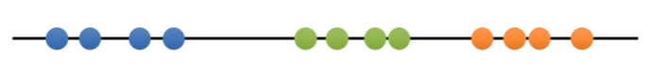
MACHINE INTELLIGENCE
K-Means Clustering Algorithm

Slide 4
MACHINE INTELLIGENCE
K-Means Clustering Algorithm
Initialization Step
a. Input Objects
b. Input K Value: Let K=3
c. Randomly choose K Cluster Centriod Objects

Slide 5
MACHINE INTELLIGENCE
K-Means Clustering Algorithm
ASSIGNMENT STEP

Slide 6


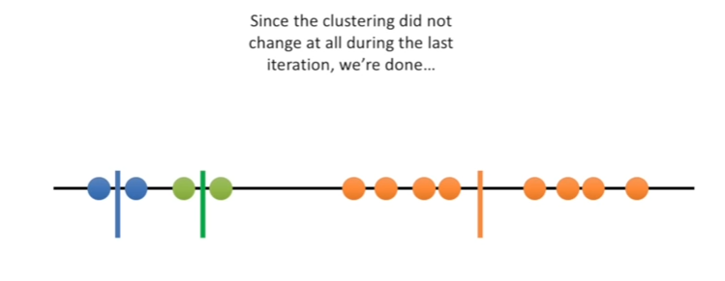
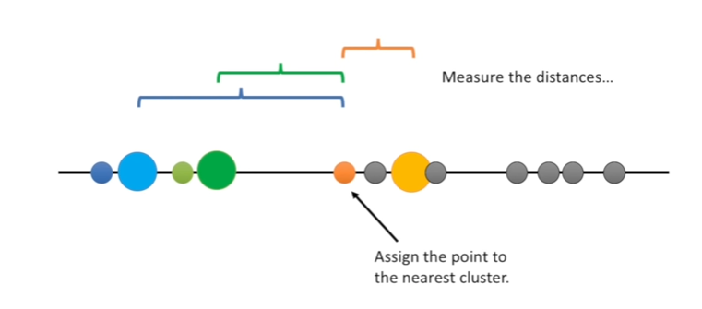
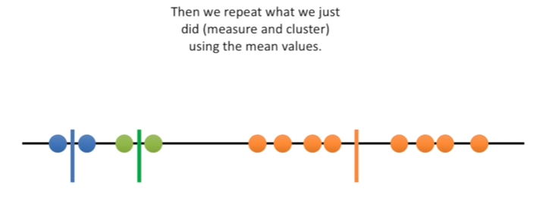
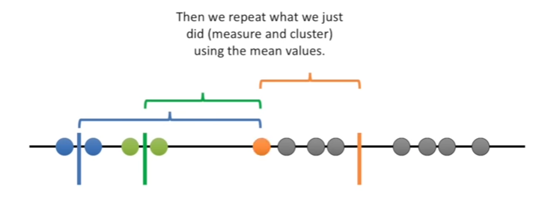
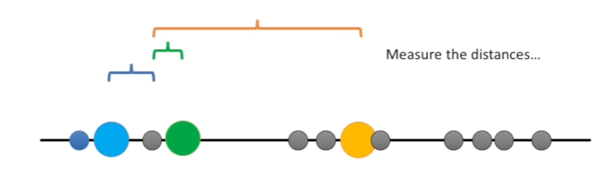
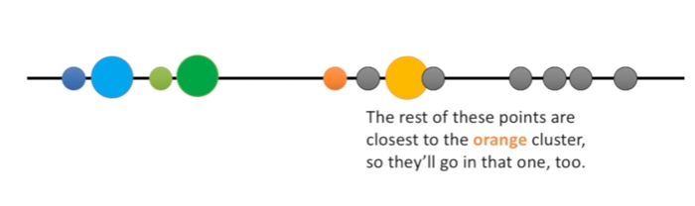
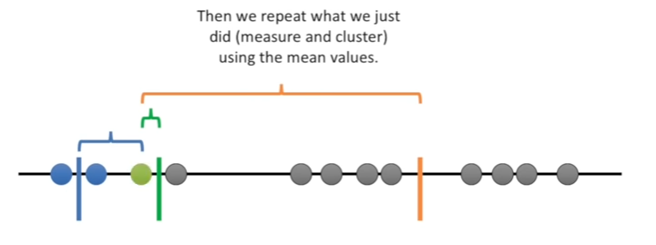
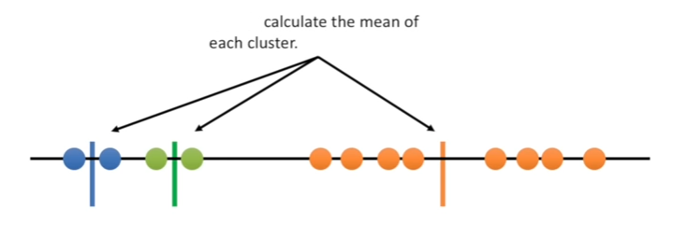
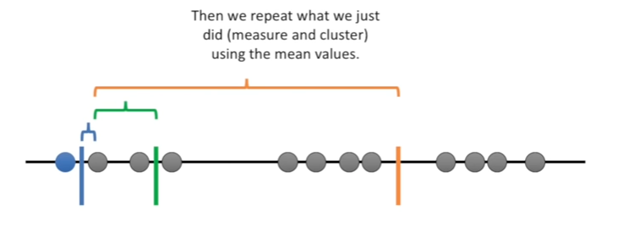
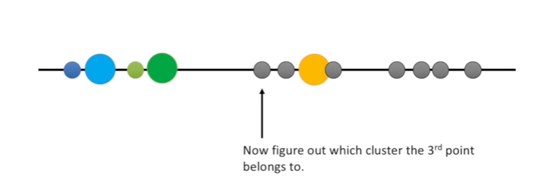
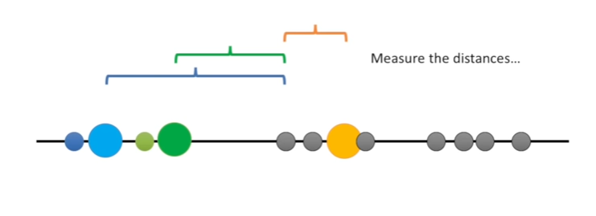
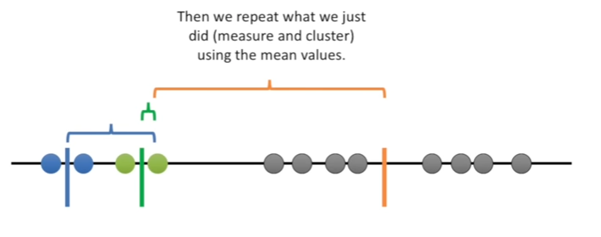
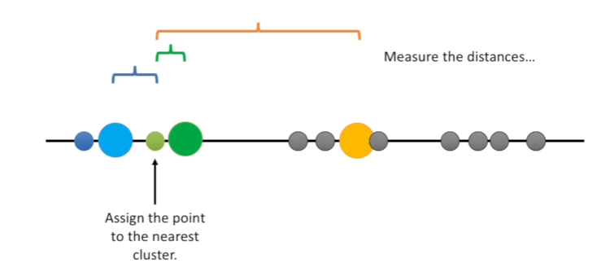
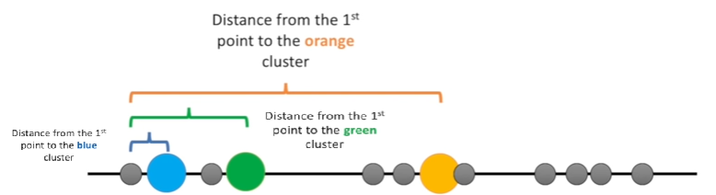
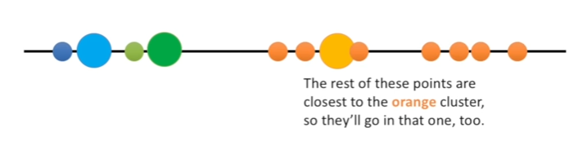
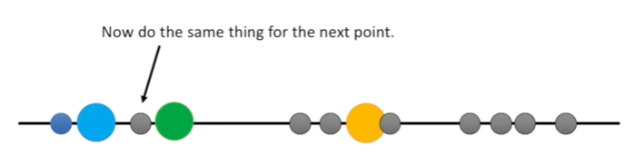
MACHINE INTELLIGENCE
K-Means Clustering Algorithm
ASSIGNMENT STEP

Slide 7
MACHINE INTELLIGENCE
K-Means Clustering Algorithm
Start
Initialization Step
Assignment Step
Update Step
Any Changes in the Centroids ?
YES
NO
Stop

Slide 8
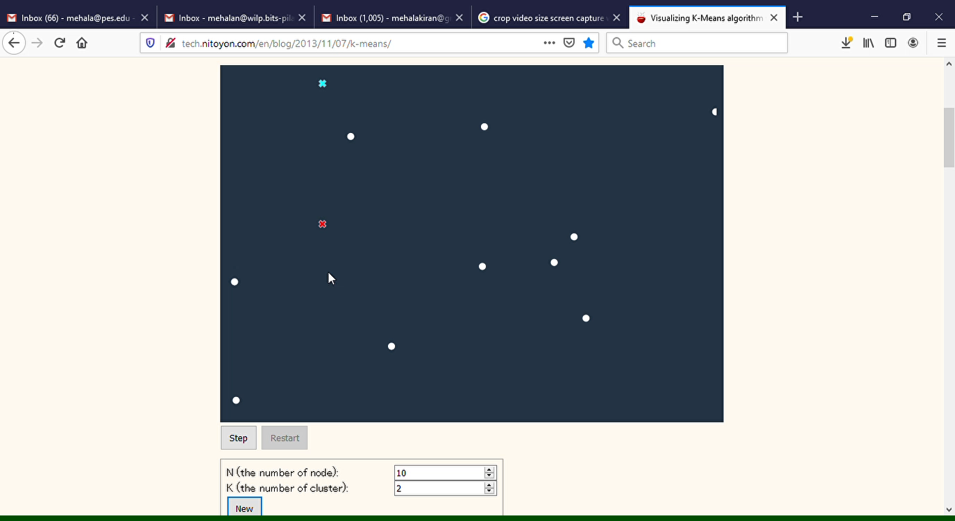
MACHINE INTELLIGENCE
K-Means Clustering Algorithm

Slide 9
MACHINE INTELLIGENCE
Resources
http://www2.ift.ulaval.ca/~chaib/IFT-4102-7025/public_html/Fichiers/Machine_Learning_in_Action.pdf
http://wwwusers.cs.umn.edu/~kumar/dmbook/.
ftp://ftp.aw.com/cseng/authors/tan
http://web.ccsu.edu/datamining/resources.html

Slide 10
THANK YOU
Dr. N MEHALA
Department of Computer Science and Engineering
mehala@pes.edu

